Slide 1
Black Box Testing on IndiaMART Website:-
Name:- Smritilata Sarkar
Mobile Number:- 6294410077
Email ID:- smritilatasarkar2018@gmail.com

Slide 2
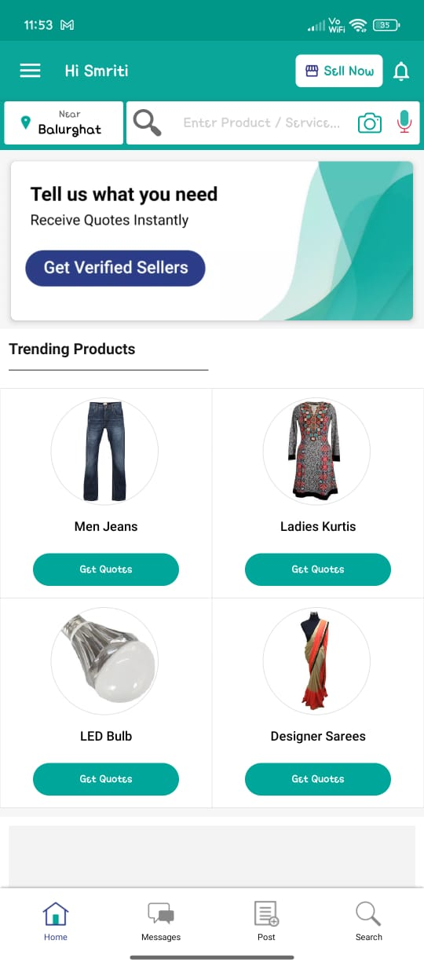
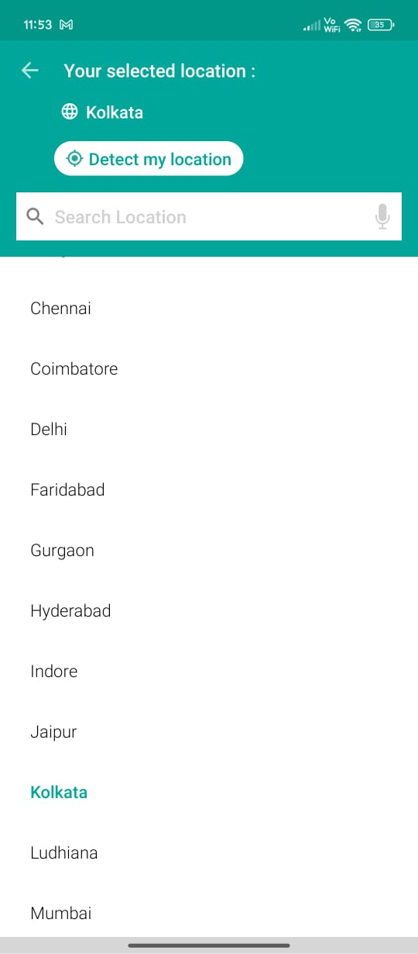
In the mobile app location showing Balurghat in the home page, but after clicking on the location it is showing Kolkata in your selected location usability defect

Slide 3
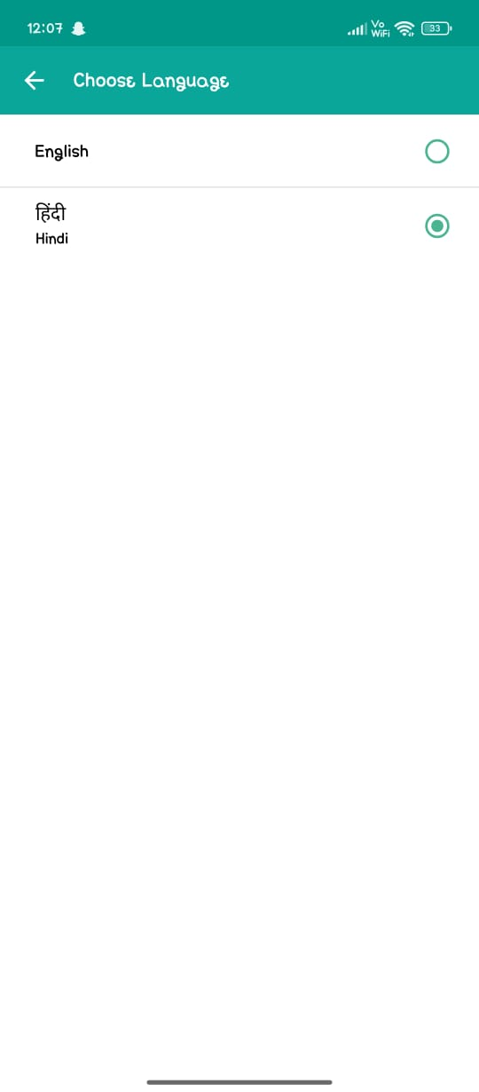
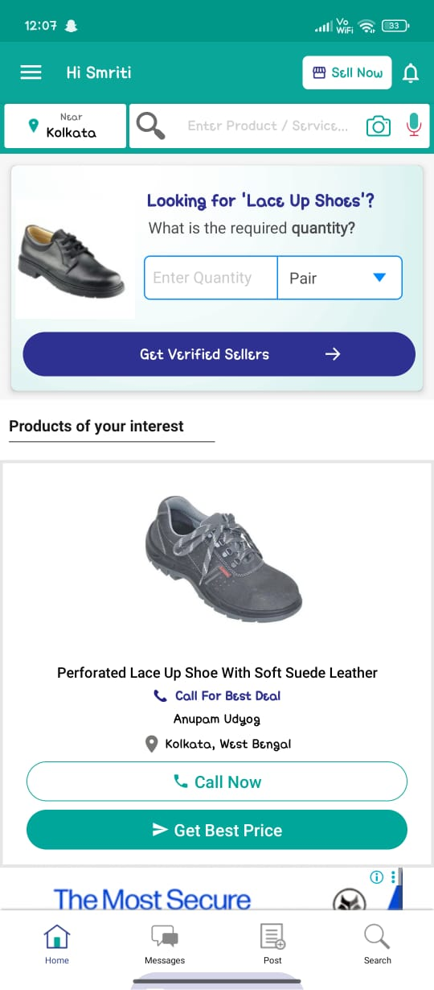
In the app selected language is hindi, but contents are showing in English Globalization defect

Slide 4
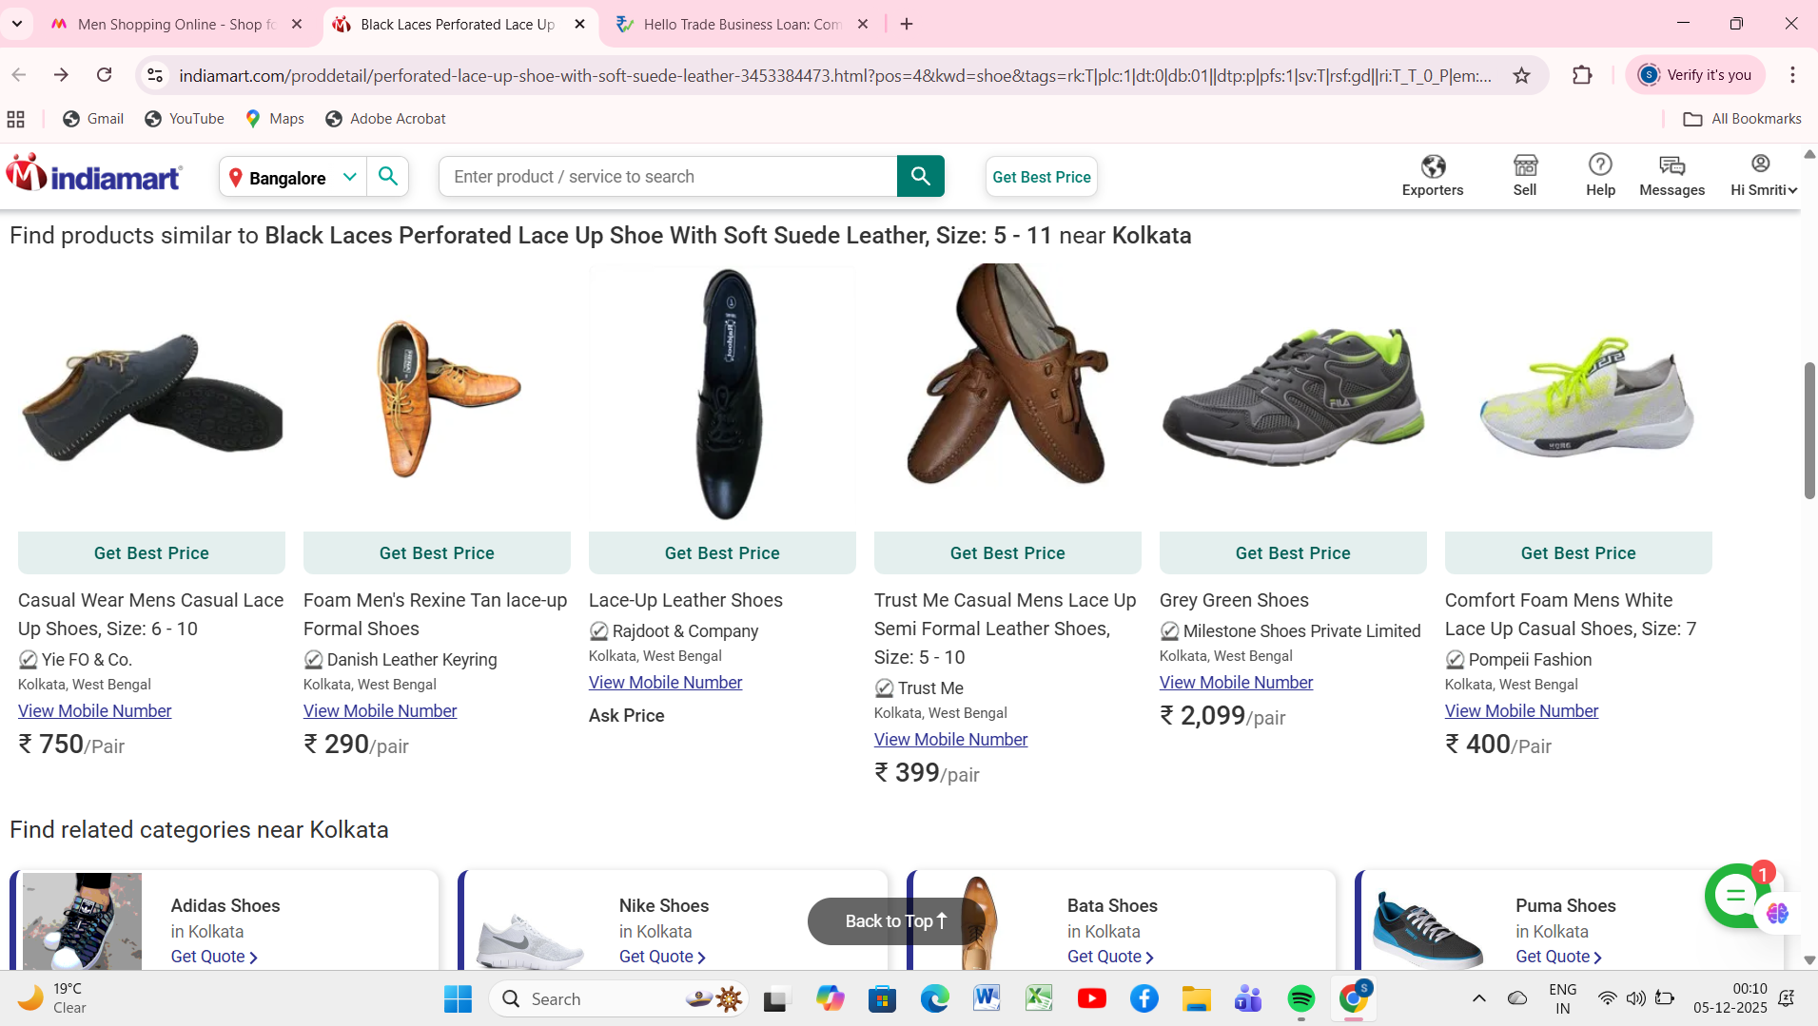
Location in selected as Bangalore but it is showing products from Kolkata Usability defect

Slide 5
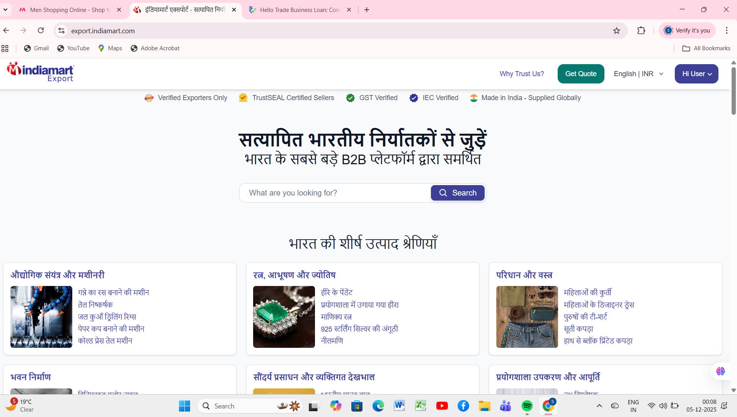
Language is selected as English but it is showing the content in hindi Globalisation defect

Slide 6
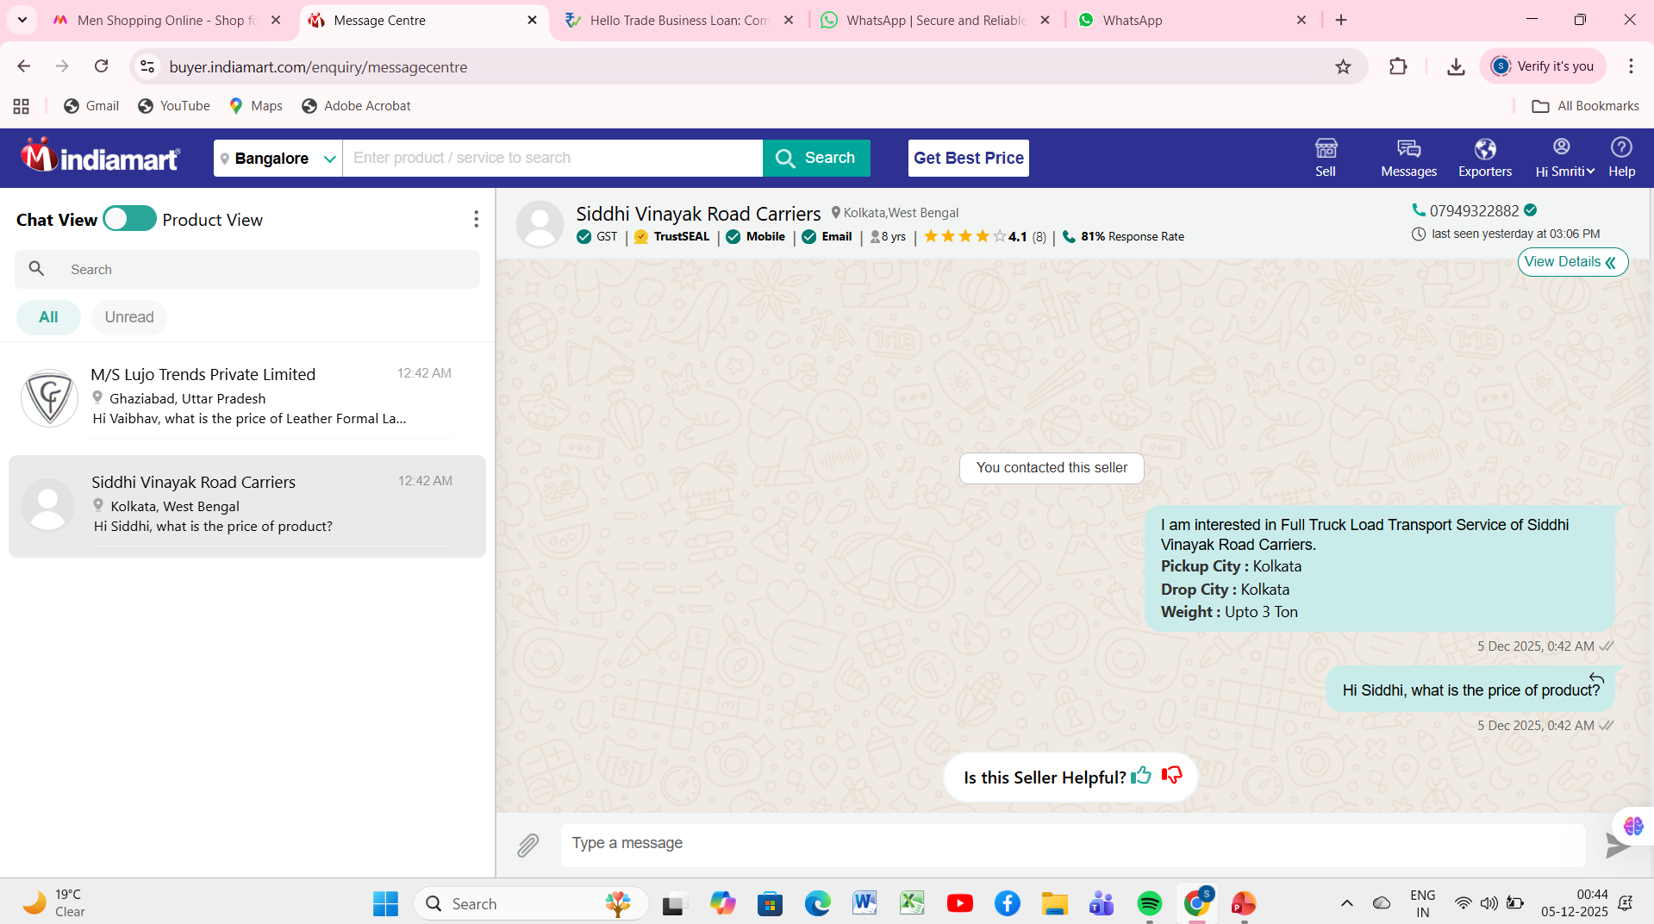
Going to home page option is not available in the page apart from the computer back button Usability defect

Slide 7
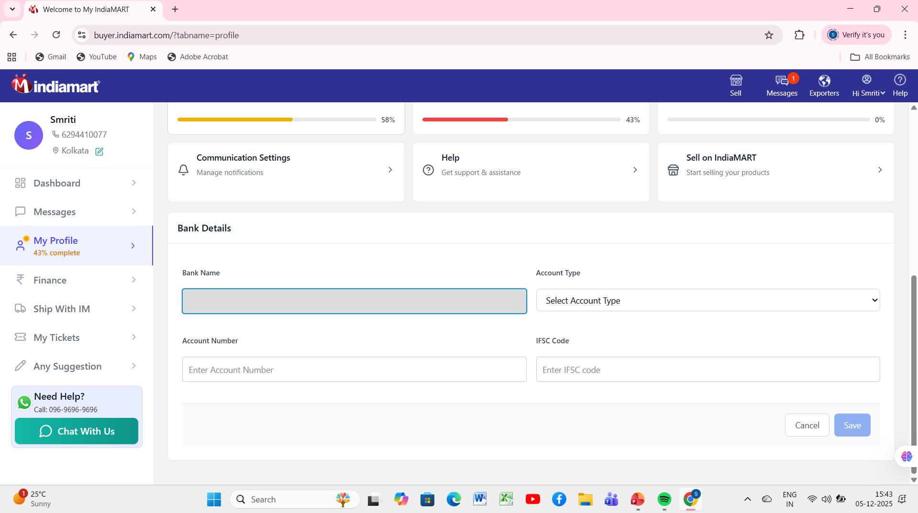
Placeholder should be there under the Bank Name:- Usability Defect

Slide 8
Astrix symbol should be there in the mandatory text fields:- Usability Defect:-

Slide 9
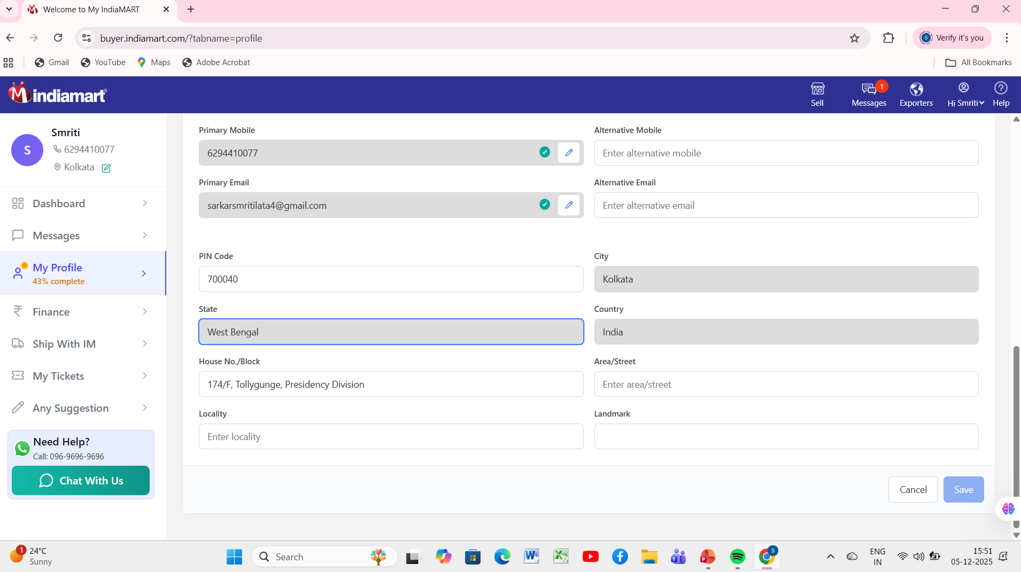
Proper Placeholder isn’t present there:- Usability Defect:-

Slide 10
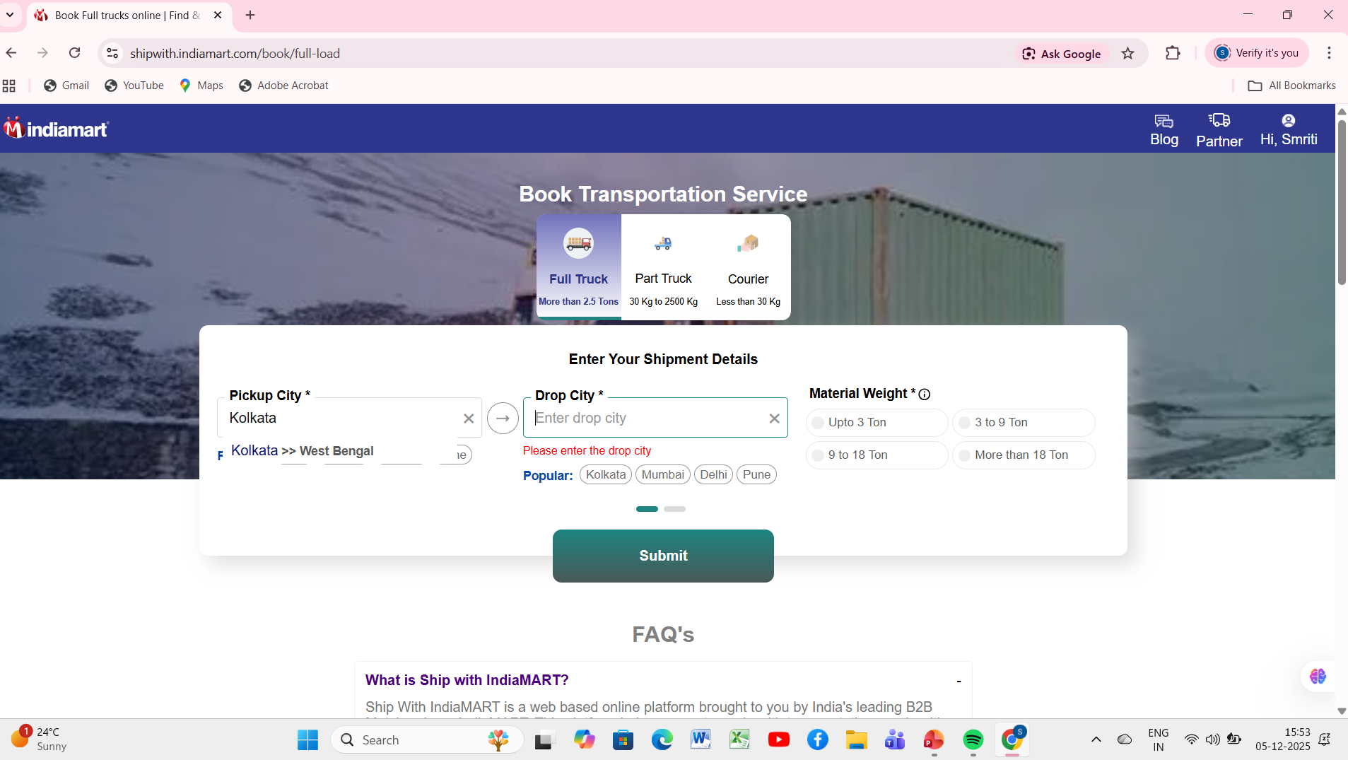
DropDown button isn’t there:- Usability Defect:-

Slide 11
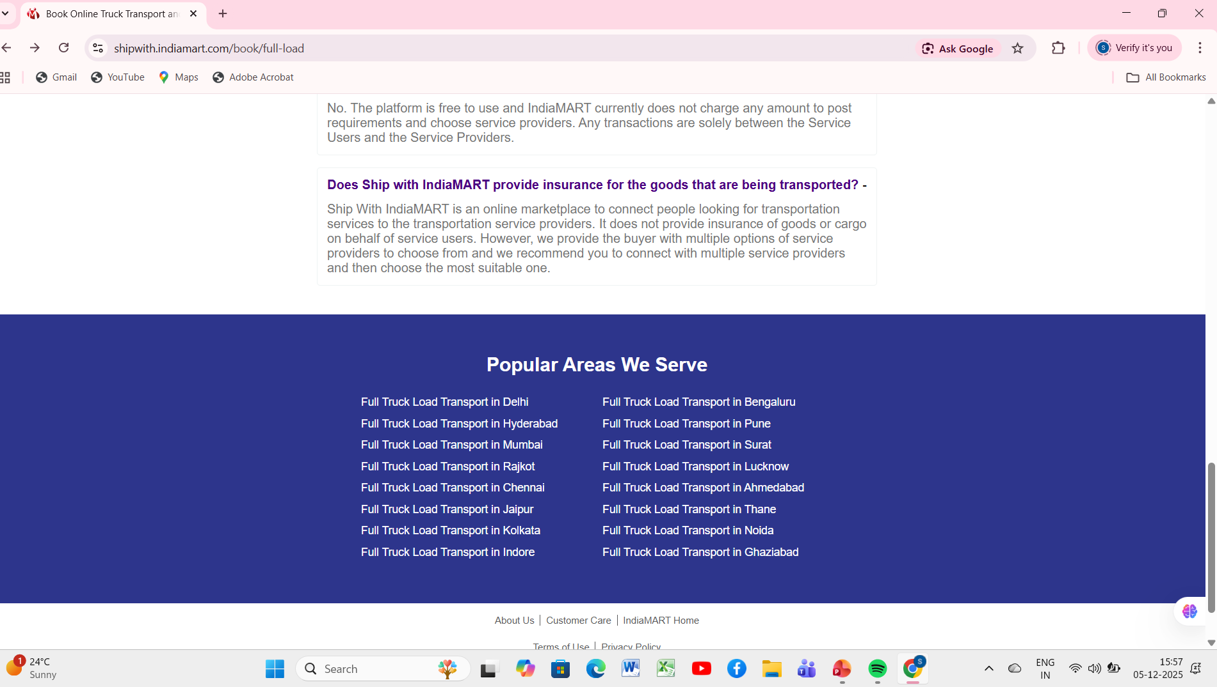
HyperLinks should be underlined:- Usability Defect:-

Slide 12
ENHANCEMENT
UI should be user-friendly
Add a back navigation button
Placeholder needs to be correct and visible
All links should appear clear and highlighted
Mandatory fields should contain astrix symbol
Software should be easy to operate

